Slide 1
RMS 111 INTRODUCTION TO BUSINESS AND MANAGEMENT
Ruaha Catholic University
Lecture 07 (a) : Introduction to IT Project Management

Slide 2
Defining a Project
An expected end date, and beginning date
Require resources and planning
A project is a temporary
endeavor undertaken to create
a unique product, service, or result.
Deliverables that are customized*

Slide 3
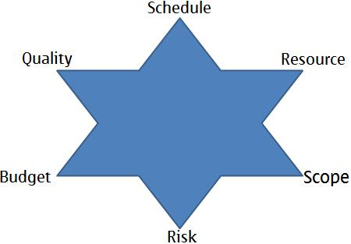
Project Contraints
To create a successful project, a project manager must consider balancing the competing project constraints, which include, but are not limited to:
Scope,
Quality,
Schedule,
Budget,
Resources, and
Risks.

Slide 4
PMI and PMP
The Project Management Institute, or PMI, is a project management professional association (established 1969 in USA).
URL: http://www.pmi.org/membership.aspx
Project Management Professional (PMP) is an internationally recognized professional designation offered by the Project Management Institute (PMI).
The PMP certification provides a globally recognized accreditation of a competent team leader in managing projects.

Slide 5
PMBOK Guide
The Project Management Body of Knowledge (PMBOK) is a set of standard terminology and guidelines (a body of knowledge) for project management.
is a formal document that describe established norms ,methods and practices.
Guidelines for managing individual projects
A good practices which applicable to most projects most of the time
A common vocabulary within project management professional
A foundational project management reference
The body of knowledge evolves over time and is presented in A Guide to the Project Management Body of Knowledge (the PMBOK Guide)

Slide 6
The Context of IT Projects
IT projects can be very diverse in terms of size, complexity, products produced, application area, and resource requirements
IT project team members often have diverse backgrounds and skill sets
IT projects use diverse technologies that change rapidly; even within one technology area, people must be highly specialized

Slide 7
Information Technology (IT) Project Management
IT project management includes overseeing projects for software development, hardware installations, network upgrades, cloud computing and virtualization rollouts, business analytics and data management projects and implementing IT services.
IT projects involve using hardware, software, and networks to create a product, service, or result.

Slide 8
Why is there interest in Project Management?
Resources Are Limited
Jobs Are Regularly Underestimated
Missed Schedules Are Common
Staff / Support Downtime is a Wasted Resource – Time Lost Cannot Be Recovered
To Get the Most For the money Invested – Value
Project Management Can Improve the Way We Do Business – Plan, Do, Check, Act
Provides a consistent vocabulary and way to do business

Slide 9
Why use Formal Project Management?
Keep costs, timeframes and resources to budget
Improved customer relations.
Shorter development times.
Lower costs.
Higher quality and increased reliability.
Reduce the chance of a project failing
Improved productivity.
Better internal coordination.
Higher worker morale (less stress)
Project tracking from start to finish; nothing falls through the cracks.
Make things simpler and easier for staff with a single point of contact running the overall project
Expedited updates and corrections when a challenge occurs
Improvement of overall project management.

Slide 10
Key Definitions
Project
Operation work
Programs
Portfolios

Slide 11
Project vs Operations Work
Project
Operations
Purpose: Attain its objective and then terminate
Output: Unique
Start and end date
Unique product or service
Are directly related to the achievement of the organization’s strategic plan
Purpose: Sustain the business
Output: Repetitive
Ongoing
Standard product or service
Are on-going and intended to sustain the business
Adopt a new set of objectives and the work continues

Slide 12
Project vs Operations-Examples
Project
Operations
Designing a company website
Implementing a LAN
Producing an annual report
Hiring a web designer
Opening a new internet café
Responding to customer requests
Hooking up a printer to a computer
Writing a progress update memo
Filling out a project journal book
Running antivirus software

Slide 13
Project vs Operations work….
However “ Project” differ from “Operation work” they have some similarities such as:
Performed by people
Constrained by limited resources
Planned, executed, and controlled

Slide 14
Projects, Programs, and Portfolios
Projects
A project - temporary endeavor + creates a unique product, service or result.
Many companies have multiple projects underway at any given point in time.
Collectively, these projects are referred to as programs.
Program management is the management of multiple projects that share resources, tools, time, and talent.
A project may or may not be part of a program but a program will always have projects.

Slide 15
Project, Portfolio and Program Management
Portfolios are collections of projects and/or programs.
Portfolio refers to a group of related or non-related projects or programs. A portfolio can consist of multiple programs or multiple projects without having a single program
Portfolio, program, and project management are aligned with or driven by organizational strategies.
Conversely, portfolio, program, and project management differ in the way each contributes to the achievement of strategic goals.

Slide 16
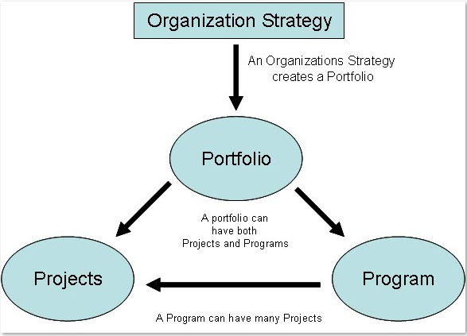
Projects, Programs, and Portfolios

Slide 17
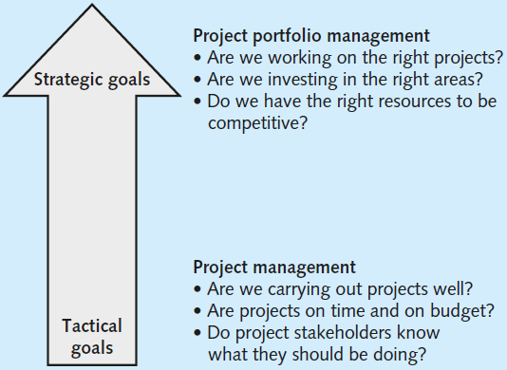
Portfolio vs Project Mngt…

Slide 18
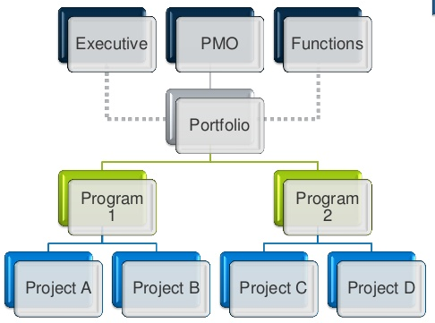

Slide 19
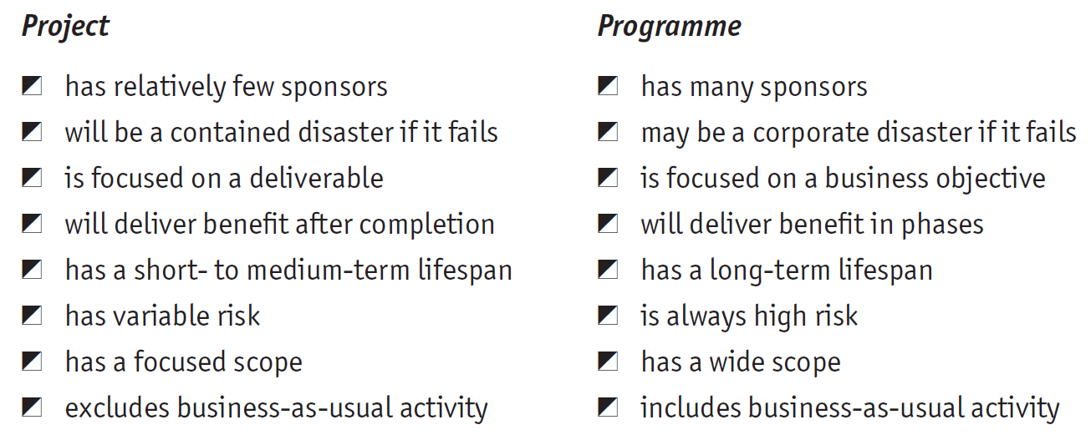
Project vs. Programme
Project vs. Program

Slide 20

Project Management

Slide 21
What is Project Management?
Project management is the application of knowledge, skills, tools, and techniques to project activities in order to meet project requirements (PMBOK Guide, 2013, p. 3)
should meet the needs and expectations of stakeholders for a project.
Project management is accomplished through the application and integration of the five key processes
Project management processes fall into five groups:
Initiating
Planning
Executing
Monitoring and Controlling
Closing

Slide 22
Managing Project
Project Manager is the person who is responsible for the project and will be held accountable for its success or failure.
Managing a project includes, but is not limited to:
Identifying requirements;
Addressing the various needs, concerns, and expectations of the stakeholders in planning and executing the project;
Setting up, maintaining, and carrying out communications among stakeholders that are active, effective and collaborative in nature;
Managing stakeholders towards meeting project requirements and creating project deliverables;
Establishing clear and achievable objectives
Balancing the competing demands of quality, scope, time , cost and risks.

Slide 23


Managing Project….
A program manager provides leadership and direction for the project managers heading the projects within the program
Management
involves the practice of scheduling, planning, budgeting, and other purely administrative activities that have predominantly a task focus. That is, management deals with the work which must be done.(Lewis,2008:20)
Leadership
is defined as the art of getting others to want to do what must be done. A leader influences people to do the work that must be done. It involves dealing with individuals, and requires knowledge of what makes them “tick,” in order to be effective. .(Lewis,2008:21)

Slide 24
Role of a Project Manager
Project issues
Disseminating project information
Mitigating project risk
Quality
Managing scope
Metrics
Managing the overall work plan
Implementing standard processes
Establishing leadership skills
Setting expectations
Team building
Communicator skills
Process Responsibilities
People Responsibilities
Notes:
Process Responsibilities
The project manager normally is responsible for defining and planning the project. This results in the completion of a Project Definition and a project workplan. Once the project starts, the project manager must successfully manage and control the work, including:
Identifying, tracking managing and resolving project issues
Proactively disseminating project information to all stakeholders
Identifying, managing and mitigating project risk
Ensuring that the solution is of acceptable quality
Proactively managing scope to ensure that only what was agreed to is delivered, unless changes are approved through scope management
Defining and collecting metrics to give a sense for how the project is progressing and whether the deliverables produced are acceptable
Managing the overall workplan to ensure work is assigned and completed on time and within budget
To manage the project management processes, a person should be well organized, have great follow-up skills, be process oriented, be able to multi-task, have a logical thought process, be able to determine root causes, have good analytical ability, be a good estimator and budget manager, and have good self-discipline.
People Responsibilities
In addition to process skills, a project manager must have good people management skills. This includes:
Having the discipline and general management skills to make sure that people follow the standard processes and procedures
Establishing leadership skills to get the team to willingly follow your direction. Leadership is about communicating a vision and getting the team to accept it and strive to get there with you.
Setting reasonable, challenging and clear expectations for people, and holding them accountable for meeting the expectations. This includes providing good performance feedback to team members
Team building skills so that the people work together well, and feel motivated to work hard for the sake of the project and their other team members. The larger your team and the longer the project, the more important it is to have good team-building skills.
Proactive verbal and written communicator skills, including good, active listening skills.
Multiple Roles
Depending on the size and complexity of the project, the project manager may take on other responsibilities in addition to managing the work. For instance, the project manager may assist with gathering business requirements. Or they may help design a database management system or they may write some of the project documentation. Project management is a particular role that a person fills, even if the person who is the project manager is working in other roles as well.

Slide 25
Interpersonal Skills of a Project Manager
• Leadership,
• Team building,
• Motivation,
• Communication,
• Influencing,
• Decision making,
• Political and cultural awareness,
• Negotiation,
• Trust building,
• Conflict management, and
• Coaching.

Slide 26
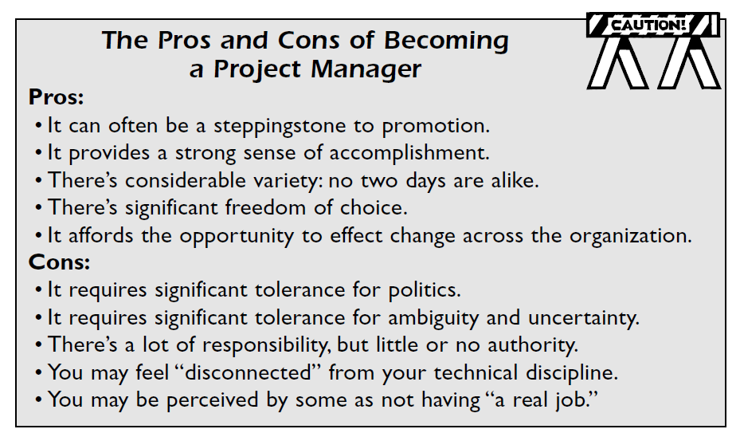

Slide 27

Project Success
Customer Requirements satisfied/exceeded
Completed within allocated time frame
Completed within allocated budget
Accepted by the customer

Slide 28

Project Failure
Scope Creep
Poor Requirements Gathering
Unrealistic planning and scheduling
Lack of resources

Slide 29
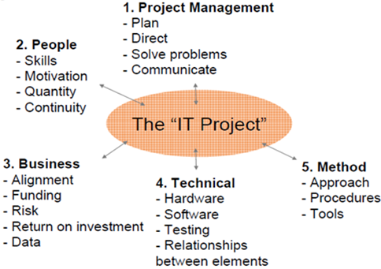
Factors that influence the project success

Slide 30
END

